Slide 1
Shadow Detection and Removal
Presented by: Mostafa Khaled
Supervised by: Dr. Alaa Hamdy

Slide 2
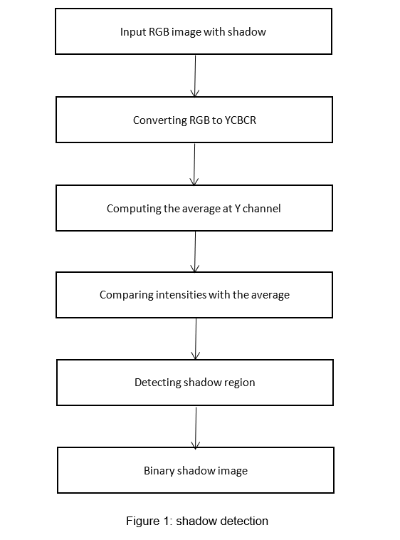
Shadow Detection
For shadow detection, a method based on intensity statistics is provided. The RGB image is first transformed to a YCbCr comparable image. The Y represents luminance information in the YCbCr colour system, whereas the Cb and Cr represent colour information. After that, the histogram of the Y channel is computed. In the Y channel, histogram dissension results in a stronger contrast image. Following that, the image's Y channel mean is calculated. The image is then iterated by sliding-window iteration. The size of the kernel window is 3*3 matrices. Two ways are used to determine which pixels belong in the shadow. The first step is to classify shadow pixels with an intensity smaller than one standard deviation of the entire image. The sliding window's mean and standard deviations for the non-shadow point are then computed. Shadow pixels are now defined as pixels with an intensity less than the windows' one standard deviation. A morphological procedure is also used to remove solitary pixels. Dilation and erosion are used to remove the misclassified pixels. The shadow detection procedure yields a binary shadow mask, which is utilised as input for the shadow removal process.

Slide 3
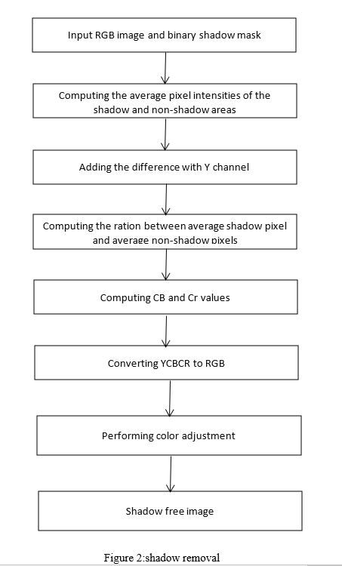
Shadow Removal
The average pixel intensities in the image's shadow and non-shadow sections are first computed, and the difference is then added to the pixels in the Y channel. The average shadow-to-non-shadow-pixel ratio is then calculated. The values of Cb and Cr are calculated next. Because of the ambient light, the ratios of the two pixels are not same in all three color channels. These two pixels will be different not only in intensity, but also in hue and saturation. Thus, correcting just the intensity of the shadowed pixels does not remove the shadow, and we need to correct the chromaticity values as well. The shadow density, which shows the degree of the light's effect, is determined using global brightness. In a sunny region, it becomes 0; in an umbra region, it becomes 1. The shadow area is divided into three regions based on shadow density: sunlight, penumbra, and umbra. The umbra zone's colour average and variance are then changed to match those of the sunshine region. Color and brightness adjustments for small sections in the penumbra are made in the same way that they are in the umbra. Finally, all boundaries between shadowed regions and neighboring lit regions are smoothed by convolving them with a Gaussian mask.

